Slide 1
Complexity-based Economic and Production Analysis: Overview and Country Report
With analysis for Brazil, China, Egypt, France, Germany, Japan, Malaysia, Mexico, Morocco, South Africa, South Korea, Spain, Turkey, UAE and USA
Soulaymane Kachani, Heyang Huang, Lun Li, Jiayu Zhao
Columbia University
September 27th, 2019
Notes:
[Greeting the audience] + [Self-introduction] + Today we will present to you a set of useful economic and production analysis tools based on the concept of complexity, an idea first brought out by Hausmann and Hidalgo in 2007.
After centuries of scientific exploration and technological progress, the world is tightly connected and steps into the era of globalization. However, we are also in an era of diversification. Affected by an increasing volume of international trade and other factors, countries are more specialized than ever in production and have diversified into distinct production patterns. National specialization begets diversity at global level. For geopolitical and historical reasons, countries are facing different economic obstacles and have developed their own strategic solution though trials. Governments are always in need of a reliable metric to assess their strategy so that they can make proper adjustment promptly. That’s the exact metric we aim to establish in the report, which uncovers the economic path countries goes through and puts forward macro-level strategies and contingency plans for governments.
The motivation is that complexity-based economic analysis offers a fair metric to evaluate countries’ development structure and provide us with useful information on their product spaces. We have also included a set of country reports in the appendix, using the example of a group of countries in the world to illustrate the ideas.

Slide 2
Contents
1. Overview
2. Economic Complexity Framework
3. Production Analysis
4. Product Space Design
5. Macro-level Predictions
6. Appendix
7. Reference
Notes:
In today’s presentation we will do an overview of our works by introducing the framework of economic complexity, conducting production analysis, outlining methods of production space design & optimization, and evaluating the findings in a macro-level.
In specific, we examine the period of 2009-2014, from the perspective of Gross Domestic Production per Capita and product space. While GDP per Capita, the most popular monetary measure of the market value of all final goods and services produced divided by population, reflects countries’ production capability, it doesn’t take into account the structure of the product space. The product space is the set of industries a country has productive knowledge on, weighted by the relative abundance of such knowledge. Or equivalently, we can define the product space as the set of products a country capable to produce. The structure of product space indicates the amount, quality and “shape” of productive knowledge amassed by countries. The product space determines the potential and sustainability of an economy, which can be exemplified by the prolonged challenges Arab oil exporting countries have been facing. Their heavy dependence on oil production and relative lack of other productive knowledge induce unemployment, vulnerability to oil prices changes, unsustainability of economic growth, and difficulty of shifting to high-end industries.
Countries have accumulated different production knowledge and industrial infrastructure. As a result, the underlying cost of developing an industry can vary extensively, while the profitability of investing in an unfamiliar product also differs to a great extent among countries. If a country doesn’t have a robust machinery manufacturing industry as support, it has to invest enormously to excel at developing high-end weapons. If the productive knowledge imbedded in the industry can unlock the door blocking a country from a wide variety of products of higher complexity, the significance of the industry is far beyond the monetary benefits added up to the GDP per Capita.

Slide 3
1. Overview
With an increasing volume of international trade, countries are more specialized than ever in production and have diversified into distinct production patterns
Based on global export data available to us, in this report we examine countries’ growth paths and product spaces on a complexity level, during the period from 2009 to 2014
The rest of the report is organized as follows:
Section 2
Countries’ economic complexity is quantified the same way as defined by Hausmann and Hidalgo (2009)
Section 3
Products are grouped into industry families and the growth paths adopted by countries during the period are closely examined
Section 4
Analyses are conducted on countries’ sequential development strategy, sensitivity to industry upheaval and the contingency plan
Section 5
Macro-level results are used to assess countries’ structural optimality
Section 6
Country-specific results are available for further reviews
Notes:
With an increasing volume of international trade, countries are more specialized than ever in production and have diversified into distinct production patterns. Based on global export data available to us, in this report we examine countries’ growth paths and product spaces on a complexity level, during the period from 2009 to 2014. In today’s presentation we will dive into a couple of interesting and important topics.
We implement the Economic Complexity Index framework established in The Atlas of Economic Complexity Index Mapping Paths to Prosperity, by Hausmann and Hidalgo in 2007, to evaluate the structure of product space and industries for countries, which are calculated as Economic Complexity Index (ECI) and Product Complexity Index (PCI), respectively. The specific mathematical definition and derivation will be discussed later on.
We construct the ECI framework, derive optimal development strategy, and prove its relaxed optimality by contrasting it with the real-world development strategy. We put forward sequential development strategy for developing countries to optimize the expansion process of their product space. We also design sensitivity analysis and contingency plan to prepare developed and fast developing countries for upheavals in their product space, especially solutions to deal with a possible collapse of their cornerstone industries.
We attach the national report of fifteen characteristic countries to exemplify the metric and provide some intuition of what these countries are facing and how they resemble and differ from each other. The path of economic development is rife with uncertainty and misleading signals. All strategies and description derived in national reports are not one hundred percent precise or determined. In fact, we will mention some key hindrance that engenders such bias later in this presentation. We hope our report can give politicians and scientists, especially those who have access to confidential national production data, some valuable reference on the effectiveness of economic development from a perspective of economic structure.

Slide 4
2. Economic Complexity Framework
2.1 Economic Complexity
2.2 Production Matrix
2.3 Diversity and Ubiquity
2.4 Economic & Product Complexity Index
2.5 Proximity and Distance
2.6 Opportunity Gain
Notes:
We’ll first provide you with a framework of understanding our research works by summarizing and highlighting works done by Hausmann and Hidalgo in 2007. In this part we will introduce to you the concepts of economic complexity, production matrix, diversity & ubiquity, ECI & PCI, proximity, distance and opportunity gains, all of which contribute greatly to our analysis afterwards.

Slide 5

2.1 Economic Complexity
In the era of globalization, more and more economies decide to specialize in the production. The global market and international organizations allow the knowledge that is held by the few to reach many.
Global Market
Productive Knowledge
Productive Knowledge
Productive Knowledge
Notes:
-The first concept that we want to dive into, which is also the key idea throughout the whole research project is – “economic complexity”.
-As we all know, the globalization process makes the world-wide trade activities much more transparent than before. To maintain a competitive position in within the ”Global Market”, countries have to
Specialize in the productions areas where they have the most productive knowledge with. The global market and emerging international organizations allow the knowledge that’s held by the few to reach many. To help countries
make better production plans with the help of data present in the market, we did a thorough research on the topic of “economic complexity”

Slide 6
2.1 Economic Complexity
There are two types of productive knowledge:
Explicit Knowledge
that can be transferred easily by reading and listening
Weather forecast
Bus schedule
Tacit Knowledge
that requires a systematic and time-consuming learning process to transfer
Semiconductor Manufacturing
Shell oil drilling
History of a building
Foreign Language
A lack of crucial tacit knowledge is the hindrance that an economy faces in its development and growth
Notes:
-To start with.
-The two major types of productive knowledge are: Explicit Knowledge and Tacit Knowledge
-Explicit knowledge is relatively easier to transfer. Some examples I listed up here are: weather forecast, bus schedule, history of the buildings, etc. These information could be obtained through checking the website or asking others
-By contrast, tacit knowledge is much harder to transfer and it usually requires a systematic and time-consuming process to learn. Things like semiconductor manufacturing process and shell oil drilling techniques are really technical and cannot be learned within a short amount of time.
-For most of the countries, especially those that are still in developing phases, the biggest obstacle that they are facing is the lack of crucial tacit knowledge to improve its production complexity

Slide 7
2.1 Economic Complexity
Products are made of raw material with the support of capital and machinery. However, from the perspective of Economic Complexity:
Products are made of pieces of productive knowledge
Water, pigment substance, and glass
Manufacturing Machinery
How to control the tinting strength of pigments
How to mass produce glass bottles
Notes:
-The concept of “economic complexity” also offers us a new perspective to look at the manufacturing process of goods: the production of goods can be decomposed into a bundle of productive knowledge pieces.
-Below is an example that showcases the two perspectives (old vs new) to look at the production process of this ink
-On one hand, from a raw material perspective, it is made of water, pigments, glasses and under the support of manufacturing machinery
-On the other hand, it could be treated as a composition of productive knowledge such as “how to control the tinting strength of pigments” and “how to mass produce glass bottles”

Slide 8
2.1 Economic Complexity
The complexity of an economy is related to the multiplicity of useful knowledge embedded in it.
Economic complexity, therefore, is expressed in the composition of a country’s productive output and reflects the structure that emerges to hold and combine knowledge
Notes:
-Through the previous example, we get the opportunity to formally introduce you to this concept of “economic complexity”:
-The total quantity and range of productive knowledge determines the product space and productivity of a country. The complexity of an economy is, therefore, related to the multiplicity of productive knowledge amassed. To be more specific, Economic Complexity is a measure of the capability for an economy to structure and utilize the productive knowledge it has acquired.
-in other words, since the economy complexity is related to the multiplicity of useful knowledge embedded in it,
it is, therefore, expressed in the composition of a country’s productive output and reflects the structure that emerges to hold and combine knowledge

Slide 9
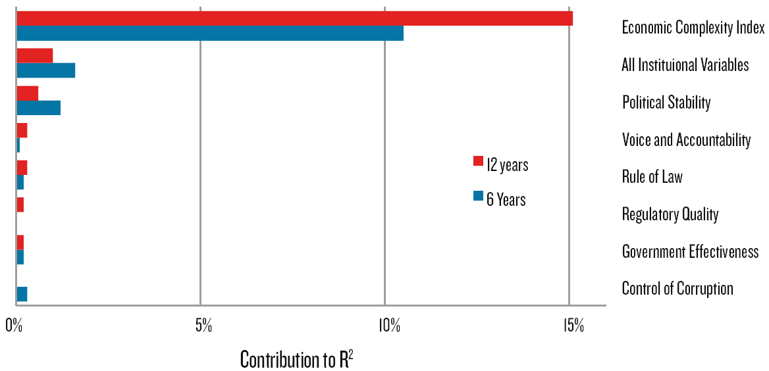
2.1 Economic Complexity
The economic complexity more effectively captures growth relevant information than the six world governance indicators.
Notes:
-Through linear regression analysis results, we could observe that, economic complexity is the factor that contributes the most to the R-square, meaning that it is the most correlated with the economic development of a country compared to other universal indicators such as: Political stability, rule of law and government effectiveness, etc.
-Such observation could solidify our argument that the research on this topic will help provide some valuable reference on the effectiveness of economic development from a perspective of economic structure.

Slide 10
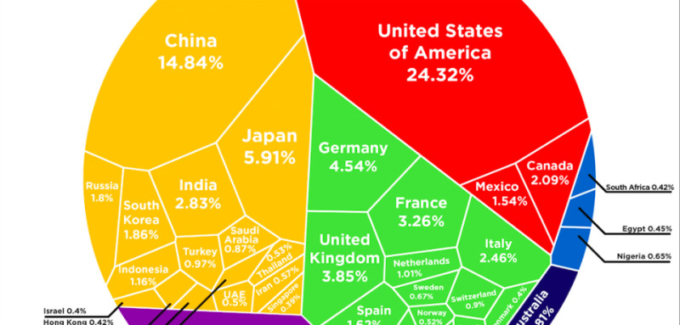
2.1 Economic Complexity
Meanwhile, the uneven distribution of productive knowledge is widening gap between rich and poor economies. The uneven distribution is expressed in the diversity and sophistication of products the economies produce.
Notes:
A quick side note, the uneven distribution of productive knowledge is widening gap between rich and poor economies. The uneven distribution is expressed in the diversity and sophistication of products the economies produce.

Slide 11
2.2 Production Matrix
When consider which products play important roles in a country’s production, we should take into account of the export volume of the country and that of the product in the world trade.
In other words, we should use comparative advantage instead of absolute advantage as our criterion.
Notes:
-The second concept we want to dive into is the one called ”production matrix”.
-With no authoritative and universal data source regarding production by industries, we estimate the production by volume of export. However, export is affected by political, geographical and all kinds of factors, hence cannot precisely represent the production. A way to improve this will be ,if we could get the access to these resources, to replace the export by actual production dataset and that should enhance the performance of the metric to a great extent.
-Instead if absolute advantage in production, we are more interested in the comparative advantage when we discuss how dominant a country is with respect to a product. For instance, due to the size and population, China is likely to have a larger volume of export in almost every product compared to Cambodia. However, in practice, Cambodia is always comparatively dominant in some products of which the national production divided by the sum of national production of all products are higher than China. Similarly, we use comparative measure to offset the fact that some products are always produced in a larger quantity across countries.

Slide 12
2.2 Production Matrix
Balassa defines Revealed Comparative Advantage (RCA) as“a country has Revealed Comparative Advantage in a product if it exports more than its “fair” share, that is, a share that is equal to the share of total world trade that the product represents.”
Accordingly, we define the matrix of comparative advantage in production for countries and products. “1” indicates the advantage, while “0” indicates the opposite
Notes:
Balassa defines Revealed Comparative Advantage (RCA) as “a country has Revealed Comparative Advantage in a product if it exports more than its “fair” share, that is, a share that is equal to the share of total world trade that the product represents.”
Formally, given the volume of production for a pair of country c and product p, we define RCA_{cp} as
${RCA}_{cp}=\frac{X_{cp}}{\sum_{c}{X_{cp}}}/\frac{\sum_{p}{X_{cp}}}{\sum_{c,p}{X_{cp}}}$-
Accordingly, we define the matrix of comparative advantage in production for countries and products. “1” indicates the advantage, while “0” indicates the opposite.
$M_{cp}=\left\{ \begin{aligned}1 { RCA}_{cp}≥1 \\ 0 Otherwise\end{aligned}\right.$

Slide 13






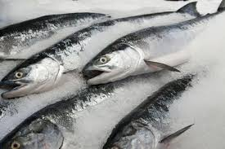
2.3 Diversity and Ubiquity
Notes:
-when we want to determine how dominant a country is in making a certain product, we have to consider the variety of productive knowledge the country holds, and the difficulty of making the product defined by the productive knowledge required in production.
-So here comes our third concept – “Diversity and Ubiquity”

Slide 14
2.3 Diversity and Ubiquity
Diversity measures how many products a country can produce
Ubiquity measures how many countries are capable to produce a product
The Diversity and Ubiquity are a pair of complements and can be used to iteratively correct each other
Notes:
While diversity measures how many products a country can produce, ubiquity measures how many countries are capable of producing a certain product. The Diversity and Ubiquity are a pair of complements and can be used to iteratively correct each other.
To help you understand the idea, here is an example. We can use a sword to peel an apple, since the sword is sharp, portable and qualified in all extents for peeling an apple. Analogically, sword has all the ‘productive knowledge’ required to peel an apple. In contrast, your laptop or Calculus textbook may not be good choices. Thus, as long as we have access to handy peelers and knives, we are less likely to use the sword, because peeling an apple doesn’t seem to be a difficult task and we have tons of options. However, if we live in a world with only a sword, laptop, Calculus textbook, and apples, then sword suddenly becomes the most “elegant” apple peeler. Whether sword is good at peeling apple also depends on the amount and competitiveness of other candidates.
As shown in the apple peeler analogy, the diversity and ubiquity are a pair of complements and can be used to iteratively correct each other. For a country with high Diversity, we go through the Ubiquity of all products the country makes to determine whether the high Diversity attributes to exceptional productivity or a mass production of low-end products. For a product with high Ubiquity, we examine the Diversity of all its production sources to determine whether the high Ubiquity indicates the product to be high-end or just less demanded. In a few iterations, the effectiveness of correction converges to zero and the cross-correction process terminates.

Slide 15
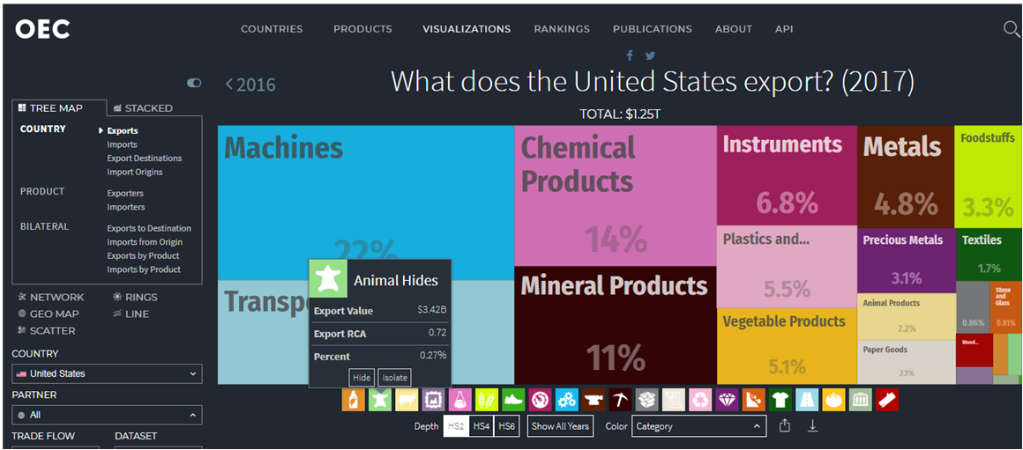
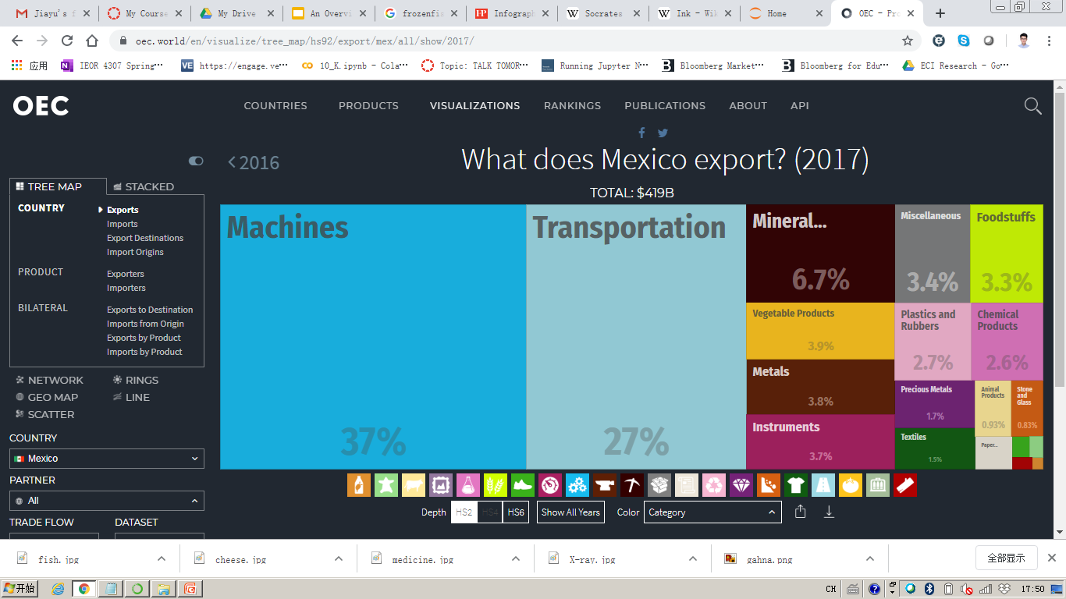
2.4 Economic & Production Complexity Index
Countries specialize in different industries with distinct level of productivity
Notes:
Countries’ production maps can be drawn based on their export data. Here we show, for instance, the goods that United States and Mexico export in 2017. The two charts provide us with direct information on which products these two countries primarily export in that year. However, how do we know exporting chemical products is necessarily more advanced/more advantageous to exporting machines or transportation? We need to find a measure to quantify and qualitatively evaluate countries’ exports utilizing the idea of ubiquity and diversity aforementioned.

Slide 16
2.4 Economic & Production Complexity Index
Products
Connectedness
Integrated Circuit
Weapon Parts
Computers
Bovine Meat
High complexity products are connected with a large amount of products
High complexity products are close to other products with high complexity
Notes:
Furthermore, we are able to observe that products with high level of complexities are often co-exported with other products of high complexities, meaning that these products are “closer to” each other because they require a similar set of complicated skills to manufacture. This also inspires us to observe, manage and optimize the product spaces of countries in later sections.

Slide 17
2.4 Economic & Production Complexity Index
The second largest eigenvector of M_{cc} best preserves the information about variance in the system, which is just Economic Complexity. Hence, we define the Economic Complexity Index ( ECI) as:
Where <> stands for numeric mean, and stdev stands for the standard deviation.
Similarly, we can calculate the second largest eigenvector of M_{pp’,} and define Product Complexity Index ( PCI) as
Where<> stands for numeric mean, and stdev stands for the standard deviation.
Notes:
Based on these observations, we formally define ECI and PCI here. The second largest eigenvector of M_{cc} best preserves the information about variance in the system, which is just Economic Complexity. Hence, we define the Economic Complexity Index as shown in here. Similarly, we can calculate the second largest eigenvector of M_{pp’,} and define Product Complexity Index ( PCI) accordingly.

Slide 18
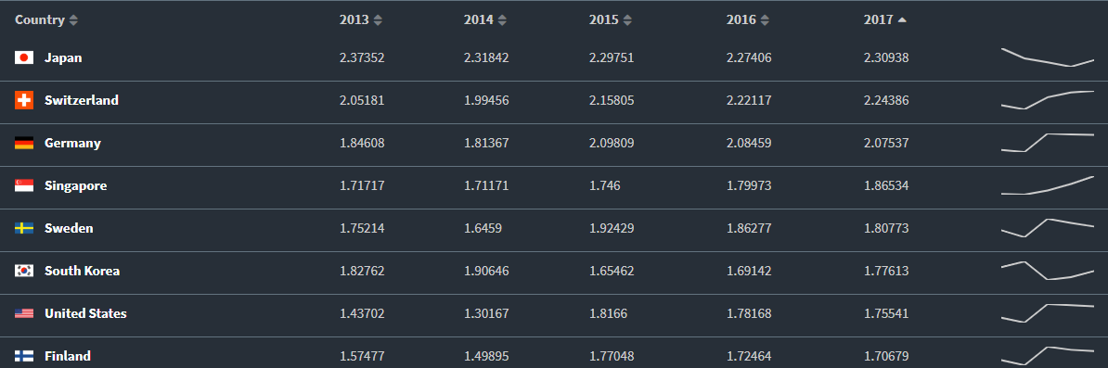
2.4 Economic & Production Complexity Index
From the trend of Economic Complexity Index in nearby 5 years, we can have a rough picture of whether the countries are on the right track of economic development.
Notes:
Here we provide a direct comparison of ECI across countries from 2013-2017. It can be seen that Japan and Germany, despite the fact that they do not have the highest GDP in the world (mostly due to a constraint of their country size and labor forces), exhibit top-tier economic complexity. The trends in general are consistent with our expectations when trying to define ”developed economies,” and reveal information on economic qualities of countries, which are typically not contained in the plain GDP numbers.

Slide 19
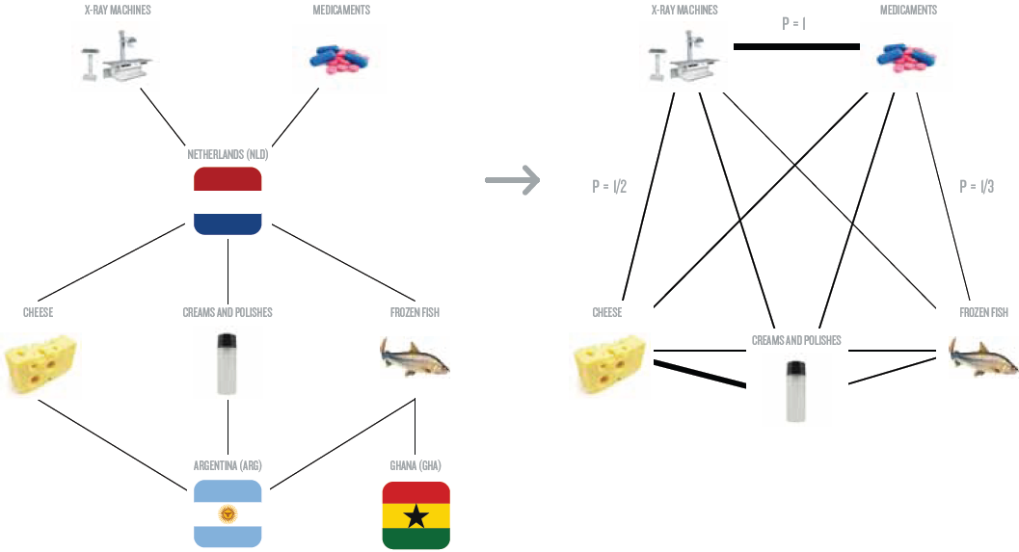
2.5 Proximity&Distance
Derive Proximity
Notes:
As aforementioned, the economy is always facing multiple paths in the journey of economic development, or equivalently, expansion of product space. While a certain sequence is efficient and reasonable for some countries, it may not be the case for others. Certain products are close substitutes. They share high proximity in a sense that possessing the productive knowledge embedded in their production resembles to each other. We then define connectedness of a product as the numeric average of proximity of it to all other products. After calculation, high-end products clearly exhibit high connectedness, while rudimental products tend to be far away from other products. The intuition is to the joint probability of co-producing two products as the estimator of proximity. However, this doesn’t work out well. Instead, we use the minimum between the conditional probability of exporting product p given the country is currently exporting product p’ and that of exporting p’ given the country is exporting p, as our measure. We choose the minimum of each pair of conditional probability to minimize the false positive rate.

Slide 20
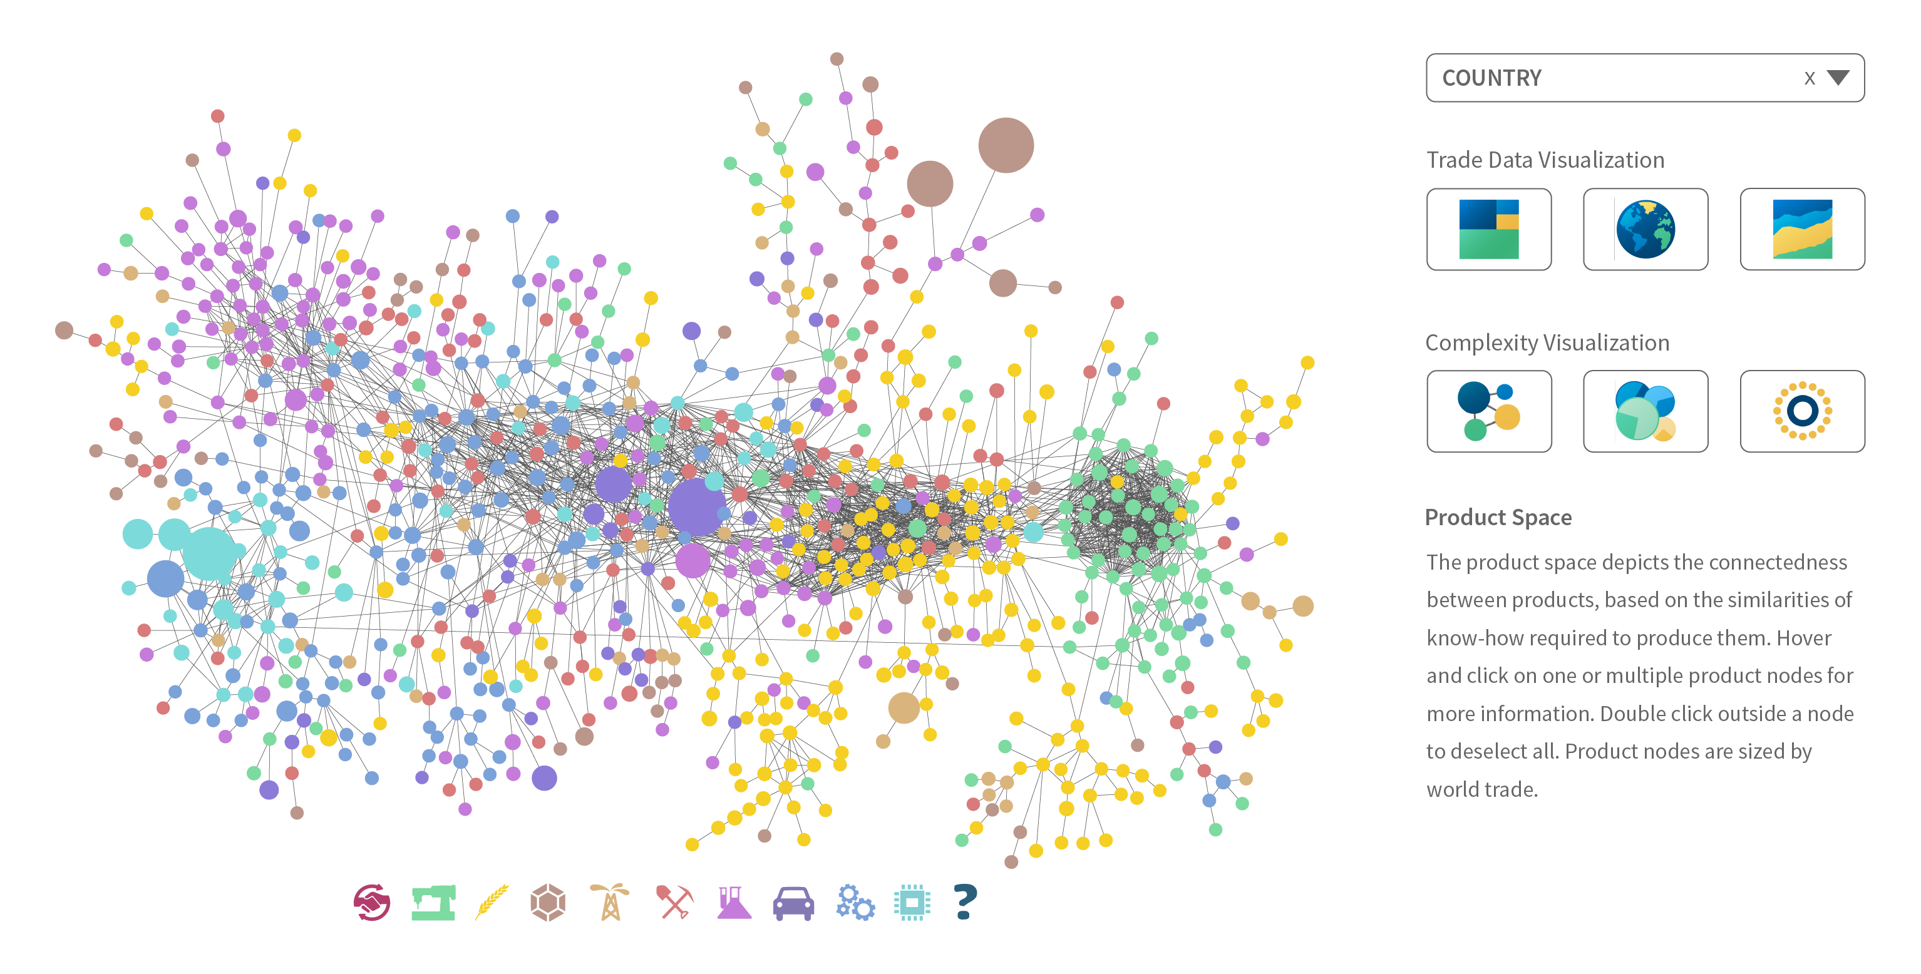
2.5 Proximity&Distance
Certain products are composed of similar productive knowledge. We define connectedness of z product as the numeric average of proximity of it to all other products
We define the smaller conditional probability of exporting product p given the country is currently exporting product p’ and that of exporting p’ given the country is exporting p, as proximity. We then normalize Proximity as Distance
Notes:
Formally, we see that certain products are composed of similar productive knowledge. We define connectedness of a product as the numeric average of proximity of it to all other products. We define the smaller conditional probability of exporting product p given the country is currently exporting product p’ and that of exporting p’ given the country is exporting p, as proximity. The difficulty for a country to produce a product outside its product space is simply the connectedness of the product to all products currently in the product space. We normalize it formally define it as Distance.

Slide 21
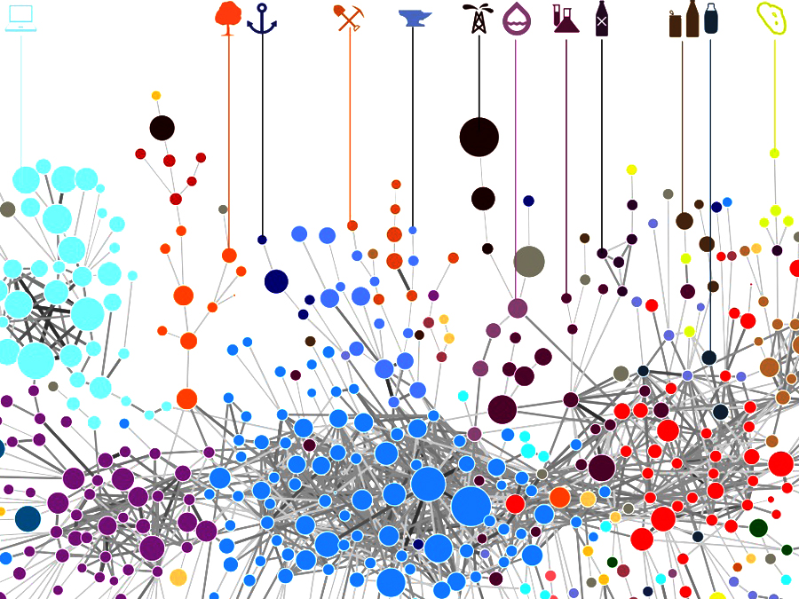
2.6 Opportunity Gain
The profit of exploring a new product is defined as the decrement of Distance to all other products far away from the product space.The Distances are weighted by the complexity of products respectively
However, the low complexity and connectedness of a product can also incur a cost that needs to be deducted from the opportunity gain
Notes:
We are still in need of an estimator of profitability. Again, the profit of exploring a new product is not limited to the increase of GDP, or any figures on fiscal report. It’s more about the decrement of Distance to all other products far away from the product space. Such products should not be weighted uniformly. The more complex a product is, the higher value it should be assigned. We first calculate the total unexploited value for a country c, before and after the advance of a new product. The difference should be the “revenue” for the country c to develop product p. The “cost” is just a measurement of the difficulty of developing the product. The Opportunity Gain is simply the “revenue” net of “cost”. There is a trade-off between the increment of Total Unexploited Value and the difficulty of developing the product. While the advance of a new product draws all products closer to the product space, the low complexity and huge distance of the product also incur a cost. If the product is an extreme outlier far from the product space, and is loosely connected to other products, the Opportunity Gain can even go negative.

Slide 22
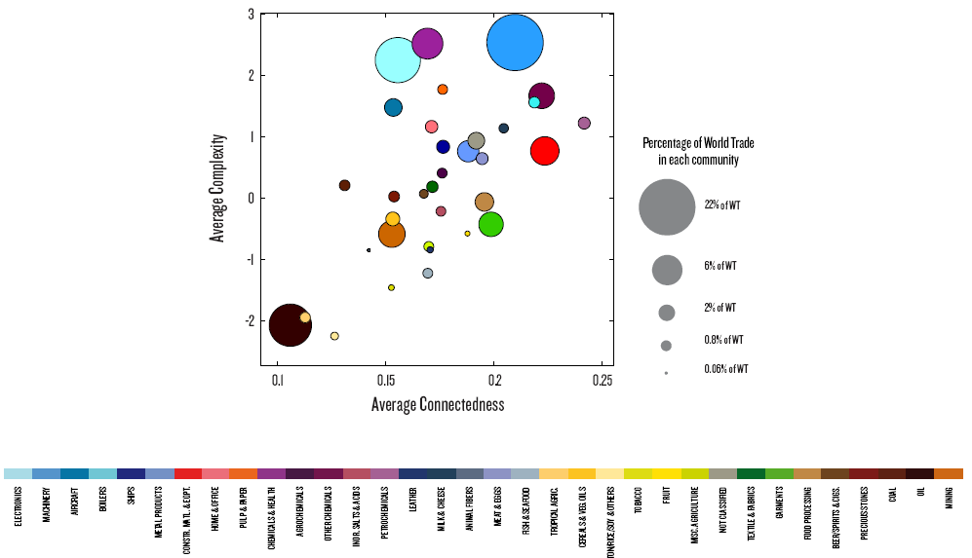
2.6 Opportunity Gain
While the product space gives us a glimpse of productive knowledge embedded in an economy,
we are still in need of a quantitative measure of the opportunity those productive knowledge implies.
We define this measure as opportunity value.
Notes:
The concept of Opportunity Gain, as well as ECI, is the foundation of the metric we introduce in the report. It’s important for us to understand that Opportunity Gain is only a conceptual estimate of the net gain of developing a product. It’s not measured in dollars or any real-world units. It is expressed in term of productive knowledge, and is too conceptual to be implemented in strategy making process directly. That’s why we further elaborate on the Opportunity Gain to calculate the marginal Opportunity Gain later on in our works.

Slide 23
3. Production Analysis
3.1 Product Categorization
3.2 Actual Development Index
3.3 Regional and Global Comparison
Notes:
We start our own works by formally categorizing the export products, defining the actual development index (ADI) and conducting regional and global comparison.

Slide 24
3.1 Product Categorization
Product groups in UN Comtrade are labelled from 010000-999999, with the first two-digits representing a category to which the product belongs
From the 99 categories as extracted from the label, we further group the products into 18 major and widely-accepted industry categories
High-tech is an aggregated industry that indicates the most complicated products from the most technologically-advanced industries, as measured by PCI, and in regression it explains over 67.6% of countries’ GDP
Animal and By-product Raw Manufacturing Transportation Vegetable, Fruit and Plant Wood Product Weapon Food and Preparation Clothing and Accessory Daily Instrument Mineral and Stone Textile Precious Stone Chemical Metal Service Chemical Manufacturing Machinery High-tech
Notes:
Our main data source in this research is the UN Comtrade Website, which provides us with valuable information on countries’ export data on an annual basis, including highly specific export data for more than 5000 categories of products. In order to have a holistic vision of the product space of a country, however, a level of categorization is required. Product groups in UN Comtrade are labelled from 010000-999999, with the first two-digits representing a general category to which the product belongs. Based on the 99 categories as extracted from the label, we further group the products into 18 major and widely-accepted industry categories, as shown in here.
Note that the high-tech industry group is not a distinct industry but rather an aggregated industry that encompasses the most complicated products from the most technologically-advanced industries (as measured by PCI). This industry serves as an indicator for us to quantitatively evaluate how well a country has performed in developing cutting-edge technologies and closing its technical gap with advanced economies, which has become a topic of wide concern today. Indeed, when we rank the 18 categories based on PfCI (i.e., Product Family Complexity Index, an equivalent concept of PCI calculated based on the 18 categorized product families), high-tech industry has the highest PfCI among all industry families.
We further observe a strong positive correlation between the GDP and the export of high-tech products. A high adjusted R-square of 67.6% exists between GDP and high-tech exports, indicating that more successful economics, as measure by GDP, tend to be those that are capable of producing and exporting high-tech products as we defined.

Slide 25
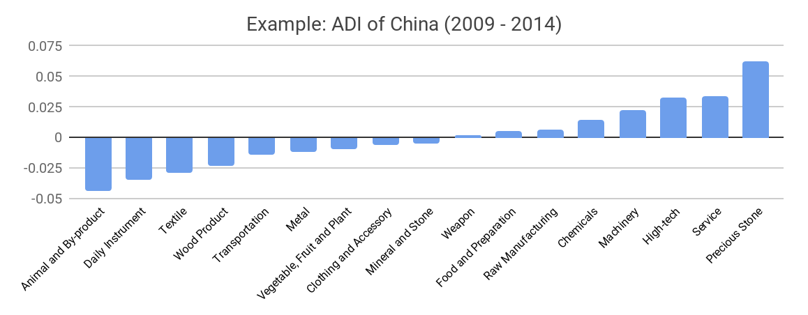
3.2 Actual Development Index
Based on this concept of distance between countries and product families, we defining the net distance change between two periods as the Actual Developmental Index (ADI)
ADI measures by how much a country has moved in the direction of a certain product family in its product space during the period, and is a relative concept
Notes:
Based on the product categorization aforementioned, the first step to understanding the prodict space of different economies is to capture their production strategies between 2009 and 2014 on a complexity level. In Hausmann and Hidalgo (2009), distance is defined to be a measure of how far a country is from a certain product not in its product space. We extend this concept to all product families and quantify how technically equipped a country is to develop corresponding product families. In other words, the shorter the distance between a country and a product group, the more capable a country is in developing products within that group.
Based on this concept of distance between countries and product families, we defining the net distance change between two periods as the Actual Developmental Index (ADI), which measures by how much a country has moved in the direction of a certain product family in its product space during the period. Our export data allows us to calculate and compare ADI of countries over the 18 product groups from 2009 to 2014, where a positive ADI indicates a shortening of the distance (i.e., relative advancement of the industry), and a negative ADI indicates the reverse. Note that this number is a normalized value that represents relative distance change in a global scale, and thus a negative value implies not an absolute degeneration of a certain industry, but rather a relative prioritization of other industries.
As shown by the example of China here, during the period from 2009 to 2014, China has focused on products with a moderate level of complexity and those requiring intermediate skills, including service, machinery and high-tech, which are rather advanced among developing economies.

Slide 26
3.3 Regional and Global Comparison
It can be observed that leading economies, such as U.S. and Germany, in general focus on products with higher level of complexity
Reasonably, emerging economies such as China, South Korea, Singapore and India have devoted the majority of their efforts into intermediate industry groups
Chemical Manufacturing
Machinery
Chemicals
Precious Stone
USA
China
Service
Wood Product
Transportation
Daily Instrument
Germany
India
High-tech
Chemicals
Notes:
The next question to ask is how the strategy adopted by countries differ from each other and what trends we can observe. Here we illustrate the production strategies, as measured by ADI, adopted by a selected group of developed and emerging economies in the world, respectively. It can be directly observed that leading economies, such as U.S. and Germany, in general focus on products with higher level of complexity. Reasonably, emerging economics such as China and India have devoted the majority of their efforts into intermediate industry groups while developed economies rely more on advanced industry groups. This trend holds true in general, regardless of the continent or the time period, and thus could serves as an indicator for which phase of development a country is currently in as evaluated from their production strategy. Nevertheless, in order to more quantitative evaluate the effectiveness of different development strategies, we dive into the product space in depth in the next section to understand how countries should develop on an individual basis.

Slide 27
4. Production Space Design
4.1 Suggested Development Vector
4.2 Sequential Development Strategy
4.3 Sensitivity Analysis
4.4 Contingency Plan
Notes:
Now that we know how countries have developed, we should continue to evaluate how they should have developed, and we do so in our works through production space design & optimization. We bring out the concepts of suggested development vector, sequential development strategy, sensitivity analysis and contingency plan to offer quantitative growth plans for countries, depending on their current level of development.

Slide 28
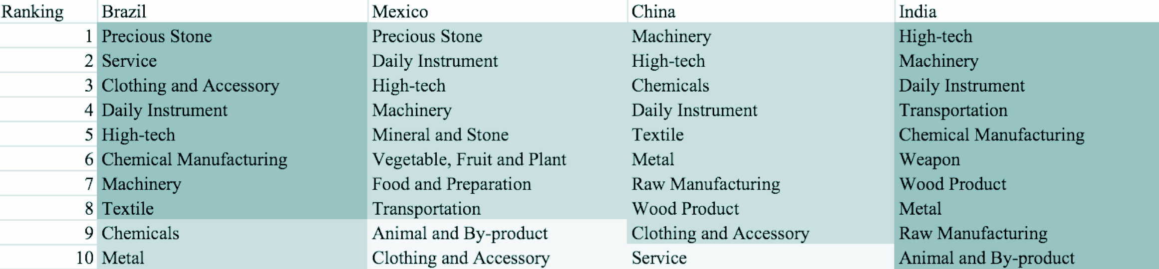
4.1 Suggested Development Vector
We define the ranking of opportunity gain of a country as the Suggested Development Vector (SDV) of the country
Leading economies are typically well-shaped and barely have any industries with positive opportunity gain, while emerging economies need a sequential strategy that allows for prioritization of certain industries
Notes:
As aforementioned, distance gives us an idea of how far each new product is from a country’s current mix of exports. As defined in Hausmann and Hidalgo (2009), distance is “the weighted proportion of products connected to goods p that country c is not exporting, i.e., MCP=0.” Based on this definition, the distance between a country and any product that the country is currently exporting (i.e., the country is a significant exporter in the product as compared to global average) is zero. Similarly, opportunity gain quantifies the contribution of a new product in term of opening up the doors to more and more complex products. Intuitively, a product that a country is currently exporting (i.e., MCP=1) has an opportunity gain of zero. And unreasonable investment on certain product p would lead to a relative decrement in export of more profitable products, and therefore lead to a negative opportunity gain of product p. The opportunity gain is not the only estimator of a country’s level of economic development. However, among countries with comparable economics quantity, those having higher ECI often have economics structures that are in better shape.
We define the ranking of opportunity gain for a country c, as the Suggested Development Vector (SDV) of c. Here we summarize the SDV of a couple of countries in the world. The result shows that leading countries barely have any industries with positive opportunity gain. In other words, those countries are already in the most stable and efficient economic structure. Without the necessity of economic transition, those countries merely need to maintain a steady and balanced economic development. In contrast, developing countries such as Brazil and India have nearly half of industries with positive opportunity gain, and share common interests in manufacturing and machinery. It is noteworthy that not all leading economies have reached a stable equilibrium in terms of their economic structure, and in fact, it is possible for developing economies to have better balanced economic structures, despite the fact that their output quantities might not be as significant on a global scale. The result shows as that the analysis conducted on an economic complexity level might serve as a complement to existing economic indicators such as GDP, which provide information on quantity but not quality of countries’ economic progress.
The aforementioned differences in economic structure between relatively advanced economies and developing economies imply that we need to adopt different methods for analyzing economies in different stages. For countries that have a large number of industries with positive opportunity gains, we need a sequential strategy that allows prioritization of certain industries to develop in the first stage. On the other hand, for countries that have already obtained a relatively stable economic structure, it is more important to answer questions such as how sensitive the countries are to shocks in various industries and what their contingency plans should be in those cases. Therefore, the rest of this section provides methods and examples to analyze those two groups of countries in a separate manner.

Slide 29
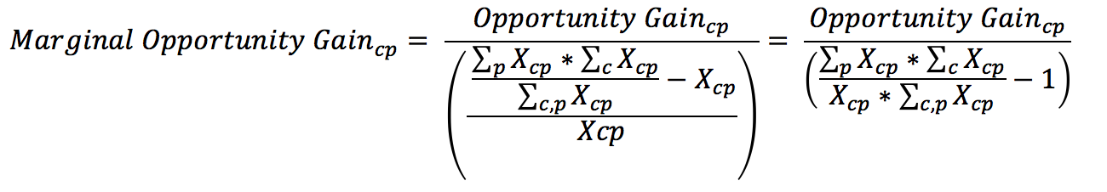
4.2 Sequential Development Strategy
As the difficulty of bumping up MCP varies across industries, we need to capture this variation of difficulty by defining the concept of marginal opportunity gains as follows
In each iteration, we order all 18 industries based on their current marginal opportunity gain, and prioritize the industry with the highest marginal opportunity gain
We then increase the prioritized industry’s export to an extent that the MCP firmly bumps up to 1, and re-perform calculations to prioritize the next industry
Notes:
The sequential economic development strategy aims to approximate the most efficient order of industrial development for countries with multiple industries to advance into. As discussed earlier, opportunity gain measures the potential profit in terms of economic complexity when a country invests on a product p to an extent such that the MCP bumps up from 0 to 1 (i.e., the country becomes a significant exporter in that product). Obviously, the difficulty of bumping up MCP varies across industries. Thus, we capture this variation of difficulty by defining the concept of marginal opportunity gains here.
In each iteration, we order all 18 industries based on their current marginal opportunity gain, and prioritize the industry with the highest marginal opportunity gain. We increase the prioritized industry’s export to an extent that the MCP firmly bumps up to 1. Then we re-perform calculations on countries’ marginal opportunity gains and update the next industry for the country to develop. Following this algorithm, we derive the iterative strategy for Morocco as an example. In Table 7, the industries are ranked by marginal opportunity gains in decreasing order, where dark grey indicates positive opportunity gain, gray indicates zero opportunity gains, and light grey indicates negative opportunity gains.

Slide 30
4.2 Sequential Development Strategy
Calculated using the sequential strategy algorithm, the example of Morocco shows how the prioritization of a developing country evolves from basic products to intermediate-level products
Notes:
We illustrate this idea using the calculation results of Morocco. The tables show that at present Morocco lacks necessary industrial power, and therefore barely has advantage in manufactured goods. Basic products such as textile, food and preparation are the foundation of intermediate-level products, and industries such as raw manufacturing and daily instrument are the second easiest step. It is noteworthy that the significance of high-tech drops extensively after the development of service re-opens the door of light industries and intermediate-level industries such as transportation and metals. Because Morocco has a large gap between its current product space and advanced product groups such as high-tech and machinery, it is extremely costly for Morocco to develop these two products even in the final stable stage, and Morocco may have a compelling industrial structure without a comparative edge in these two industry groups.
The sequential development strategy above applies when a large number of industries with positive opportunity gains are being considered, and may serve as a general reference for countries in deciding which industries to prioritize by providing information on the dollar-weighted costs of developing these industries. However, since we are pivoting the algorithm on industries of one certain country, the strategy admittedly ignores dynamics of concurrent development in other economies, i.e., possible changes in economic structure of other countries and trade flows on a global scale. In reality, the predicting power of the sequential development strategy might not be strong when the planning horizon is too long, and countries should probably consider only the first few iterations when making prioritization decisions. Nevertheless, the strength of this algorithm lies in the fact that it is easy for countries to re-calculate/update the strategies once new export information becomes available. Moreover, it is meaningful to for countries to make such calculations on a rolling basis and observe how their prioritizations have changed in the past years and whether new adjustments are needed.

Slide 31
4.3 Sensitivity Analysis
The sensitivity analysis aims to approximate the volatility of SDV subject to an increment or decrement of export and is mainly implemented on developed countries that
have few industries with positive opportunity gains.
To be more specific, sensitivity score is the least-squared slope for the linear regression between percentage change of production and that of the E _{f} CI
We perform the sensitivity analysis of the aggregate of top ECI countries, including US, UK, Korea, Japan, South Korea, Singapore, Germany, and France, and use the result as the benchmark. The sensitivity score in 2014 and 2009 are shown below:
Sensitivity Score (2014)
 | High-tech | Food and Preparation
Decremental | 1.676 | 0.007
Incremental | 1.195 | -0.006
Sensitivity Score (2009)
 | High-tech | Food and Preparation
Decremental | 1.514 | -0.001
Incremental | 1.294 | 0.007
Sensitivity Score of Benchmark in 2014
Sensitivity Score of Benchmark in 2009
Notes:
It’s worth noting that the Sequential Development Strategy is not universally applicable to all countries. It’s designed for less developed countries that have many positive Opportunity Gain industries. If there’s barely any positive Opportunity Gain industries, the Sequential Development Strategy obviously is obviously meaningless. In fact, most developed and fast developing countries fall into the category and their Suggested Development Vectors (SDV) exhibit a similar pattern.
However, there are also extreme cases, such as France in 2009. Financial hardship resulting from the global economic crisis have led to strikes, unemployment and other forms of widespread social unrest. Such upheavals further contribute to a massive regression in all industries. Hence, even though France is a well-developed country, it can also exhibit a SDV with many positive Opportunity Gain industries, which precisely represents the hardship France went through back in 2009.
Therefore, instead of focusing on how to further balance the structure of product space, developed countries should take precautions against unexpected strikes and forecast the adverse effects industry by industry. The regression of an industry with low PCI and low Opportunity Gain is less dangerous than that of cornerstone industries. High-tech is such a representative of the cornerstone industries, because High-tech connects to most of the profitable products that developed countries are currently specializing in. For the same token, Food and Preparation is one of the less fundamental industries for developed countries. Such intuition can be rigorously proved by the sensitivity analysis we are about to introduce.
The sensitivity analysis aims to approximate the volatility of SDV subject to an instant increment or decrement of export and is mainly implemented on developed countries that have few industries with positive opportunity gains. To be more specific, sensitivity score is the least-squared slope for the linear regression between percentage change of production for Country C and Product P and the EfCI of C.
When the opportunity gain of the industry is negative, the sensitivity analysis approximates how an over-development of the industry jeopardizes the economic structure of a country. When the opportunity gain of the industry is zero, the sensitivity analysis determines whether the further development of the industry shapes the country a better economic structure, and predicts how the SDV would change accordingly. Specifically, as we reduce the export of such an industry to 25%-50% of its original value, a few other industries originally with negative opportunity gain would probably become profitable. We separate the increment and decrement of production in the sensitivity analysis, because they tend to show vast difference. The extreme profitability of a spike of production doesn’t imply a shrink is always followed by a painful crisis.
As we expect, the shift of Food and Preparation production doesn’t alter the SDV at all. In contrast, the boom of High-tech can stimulate and bring extra potential to other high complexity industries, including Machinery, Transportation and Daily Instrument.

Slide 32
4.4 Contingency Plan
The Contingency Plan presents solutions to productivity decline within specific industries. Sometimes, the optimal solution to such downturns is not to invest in the industries undergoing downturns directly, but to support industries highly connected to such industries.
Contingency Plan (2014)
 | 0 | 1
High-tech | Animal and By-product | Precious Stone
Service | Service | Precious Stone
Contingency Plan (2009)
 | 0 | 1
High-tech | Mineral and Stone | Precious Stone
Service | Mineral and Stone | Precious Stone
Contingency Plan of Benchmark in 2014
Contingency of Benchmark in 2009
Notes:
The Contingency Plan aims to present a set of solutions with respect to upheavals in different industries. Instead of compensating for the declining production directly, the best strategy is to develop those incipiently profitable industries. In this manner, we can derive the contingency strategy for countries to deal with possible abrupt declines of crucial industries. In some cases, the SDV remains unchanged even when a zero-opportunity-gain industry declines to its 20% in terms of export. We can then conclude the industry is not indispensable to the country.

Slide 33
5. Macro-level Predictions
5.1 Structural Optimality Index (SOI)
5.2 SOI Examples and Implications
Notes:
Obviously, we need to justify the aforementioned suggestions on prioritization and contingency plans by illustrating their effectiveness to countries’ macroeconomic outlook. We do so by formally defining the structural optimality index and showing some examples in this section.

Slide 34
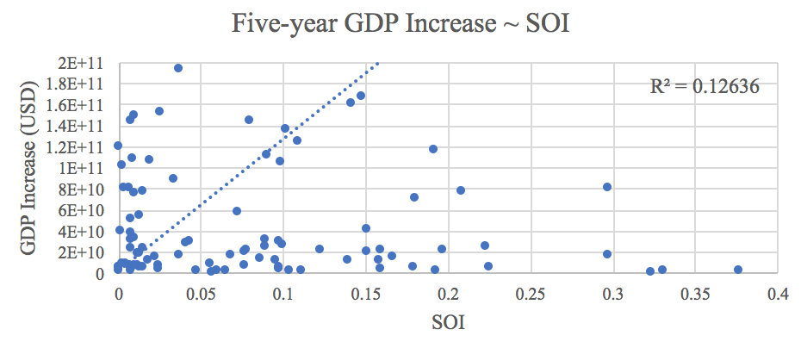
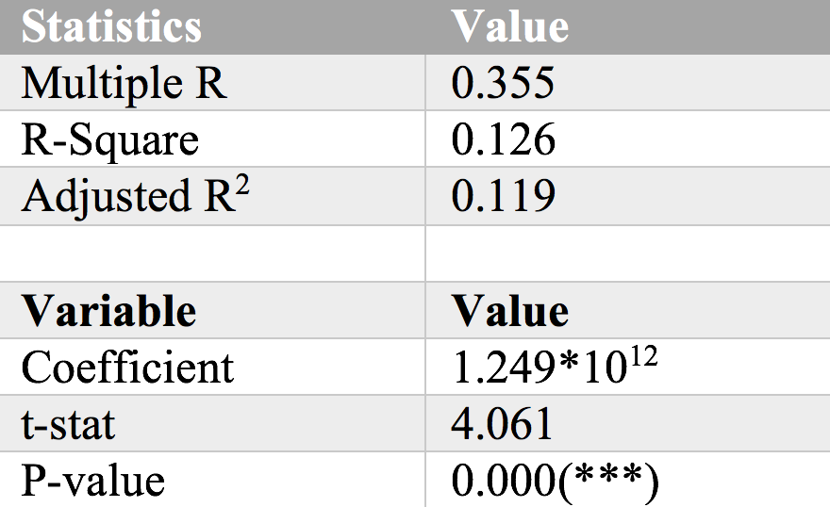
5.1 Structural Optimality Index (SOI)
Structural Optimality Index (SOI) is defined as the adjusted R-Square of export increase in industries ~ opportunity gains of industries
SOI provides a quantified measure of how the development path adopted by a country fitted with/differed from calculations on a complexity level (i.e., the opportunity gains)
We further observe a significant correlation between SOI and five-year GDP increase of countries, indicating that structural optimality does impact economic outcomes
Notes:
Indeed, such choice of prioritization has proven to be a significant factor in deciding the economic outcomes of countries. In order to quantitatively evaluate how effective our development strategies are and how deviations from the suggested developmental path will lead to suboptimal growth results, we define the measure – Structural Optimality Index (SOI) – on a country level as the R-Square obtained from regressing the country’s actual development over the suggested development strategy. Both strategies are quantified in nature, with the actual development represented by export increase in every major industry groups and the suggested development strategy represented by the opportunity gains of developing the corresponding industry groups as calculated in previous sections. The adjusted R-square from the regression thus provides us with a quantified measure of how the development path adopted by the country has fitted with/differed from calculations on a complexity level.
After obtaining this measure for all countries in our database, we further regress countries’ five-year economic growth, which as defined as the net increase in GDP (USD), over their SOI. The graph and table here illustrate the regression output, which shows a strong positive correlation between countries’ SOI and their five-year GDP growth, significant at the 1% level and achieving an adjusted R2 of 11.9%. In other words, the more a country develops as suggested by calculations on a complexity level, the better economic outcomes it achieves.

Slide 35
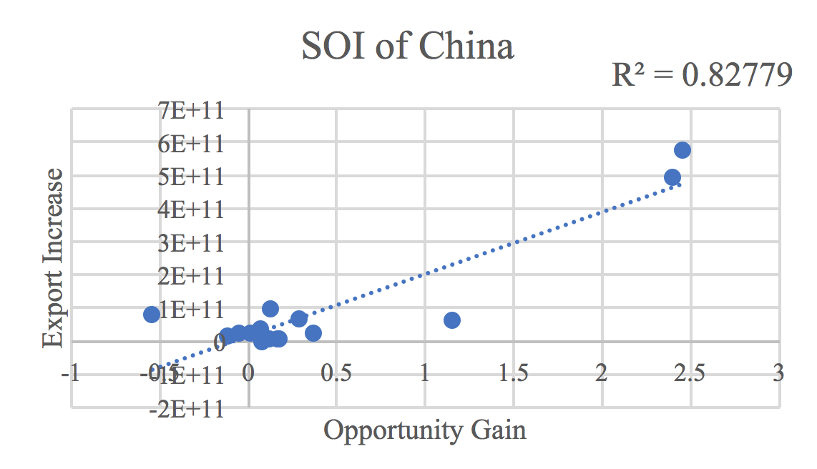
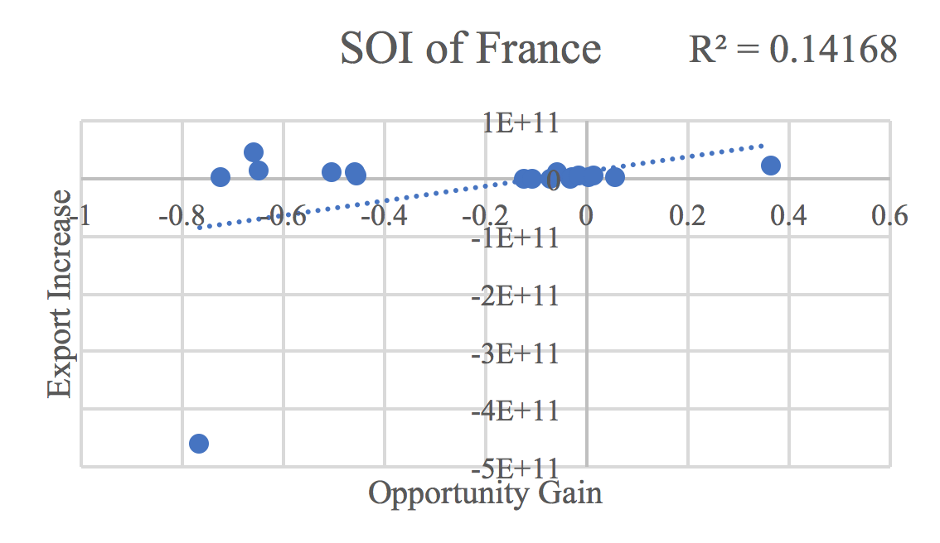
5.2 SOI Examples and Implications
Taking China and France for comparison, China ranks the 1st place among all countries in terms of SOI (82.8%), and has the highest economic growth rate from 2009 to 2014
In contrast, developed economies such as France, where there is a moderate SOI of around 14.2% and a corresponding annual growth rate of 1.1%
Intermediate-term economic progress can be at least partially explained by the optimality of development strategy that countries choose to adopt
Notes:
To explain this finding in a more intuitive way, we take China and France as a comparison. As the regression graphs here suggest, the export increases of China in various industries demonstrate a high level of correlation with the opportunity gains of those industries, having an adjusted R-square (i.e., SOI) of around 82.8%. In fact, China ranks the 1st place among all countries in terms of SOI, meaning that it is developing in quite an optimal way, and also ranks the 1st place in terms of its economic growth rate from 2009 to 2014.
The situation in China is in direct contrast to that in developed economies such as France, where there is a moderate SOI of around 14.2% and a corresponding annual growth rate of merely 1.1%, ranking it a slow-developing economy during the period. In sum, France’s stagnant economic progress from 2009 to 2014 can be at least partially explained by a mismatched development strategy that demonstrates a considerable level of deviations from the suggested developmental path as calculated through opportunity gains. In specific, France invested/exported heavily in the transportation industry, while it should have focused more on industry groups such as service and machinery, which actually have higher opportunity gains based on calculations.
The contrast of situations in China and France offers a glimpse of how the economic outcome of countries is positively associated with their structural optimality. In particular, countries such as China tend to have better growth, as measured by GDP, when they follow industry prioritization strategies closely based on opportunity gains, and the reverse is true for countries such as France. While a strict causality is hard to be established in this case because it is hard to control variables in such natural experiments, the correlated phenomenon is widely observed across different time spans of our interest. This implied that the calculations and further research on a complexity level are of importance and great values to countries, and may offer a guide for them to properly access and prioritize certain industries in face of practical constraints such as time and budget.

Slide 36
6. Appendix
In this section we outline the most important calculations & analysis results for a selected group of countries, including Brazil, China, Egypt, France, Germany, Japan, Malaysia, Mexico, Morocco, South Africa, South Korea, Spain, Turkey, UAE and USA
For each country, we highlight its GDP & ECI trend, Actual Development Index (ADI), Suggested Development Vector (SDV), sensitivity score & plan, contingency table and Structural Optimality Index (SOI) during the period
Notes:
In conclusion, we follow the footsteps on previous works related to Economic Complexity Index and put in more analysis on the product space for each country into the general framework. In particular, we categorized the highly specific global export data available on UN Comtrade to 18 manageable and intuitive industry categories. Extending the definitions of product complexity index to product families, we calculate distance between countries and product families in a corresponding manner and observe how countries have positioned themselves in their product space during the time span of our interest.
We then dive into the question of how countries should develop given their current position in the product space and solve for strategies for countries on an individual basis. We propose a sequential development strategy for developing economies to prioritize certain industries in their expansion of their product space. We also put forward sensitivity analysis and contingency plan to prepare developed and fast developing countries for upheavals in their product space, especially solutions to deal with a possible collapse of their cornerstone industries.
In particular, we come up with the structural optimality index to quantitatively measure and compare the strategies adopted by countries against the suggested developmental path. Regression shows a strong positive correlation between countries’ structural optimality and their economic outcomes, measured by GDP growth. This suggests that countries’ product space, as well as decisions to be made on the product space, are of great research values to economies and more works remain to be done in order to obtain a deeper understanding of how countries interact on the global production network.
More detailed analyses of fifteen selected economies can be found in the appendix of this presentation, and they largely represent how countries of each kind should develop in this ever-changing global market.

Slide 37
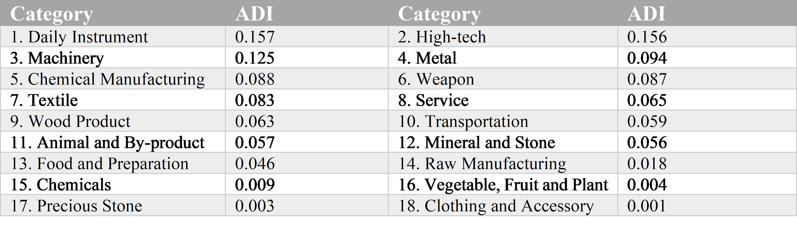
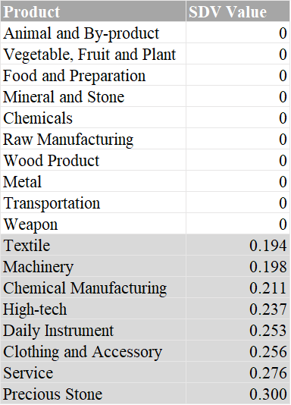
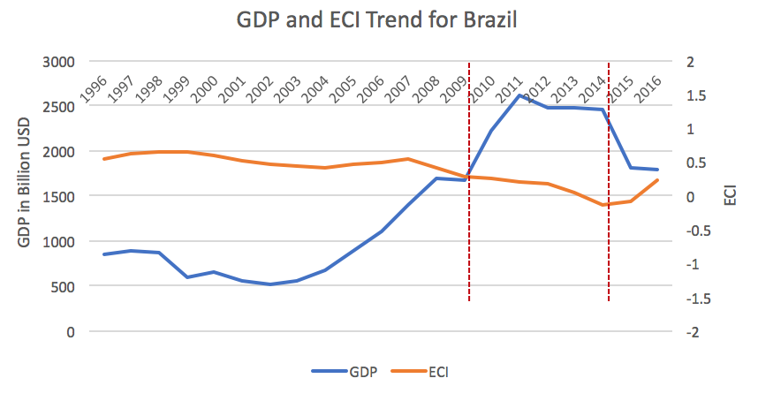
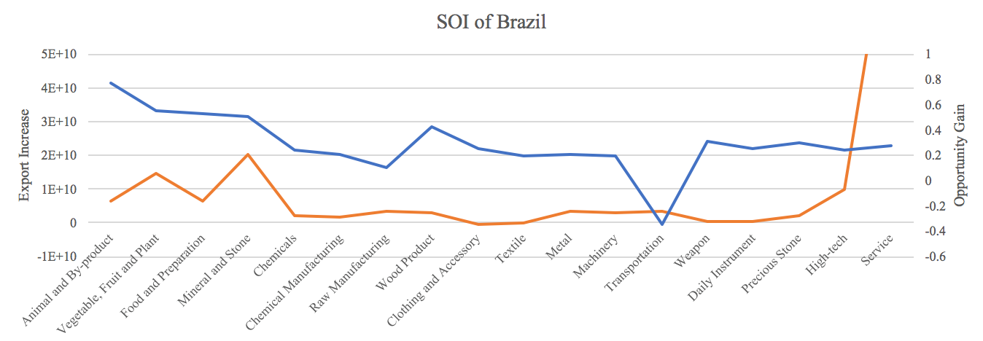
6.1 Brazil
Table 1: Actual Development Index (ADI)
Table 2: Suggested Development Vector (SDV)
SOI=0.8%

Slide 38
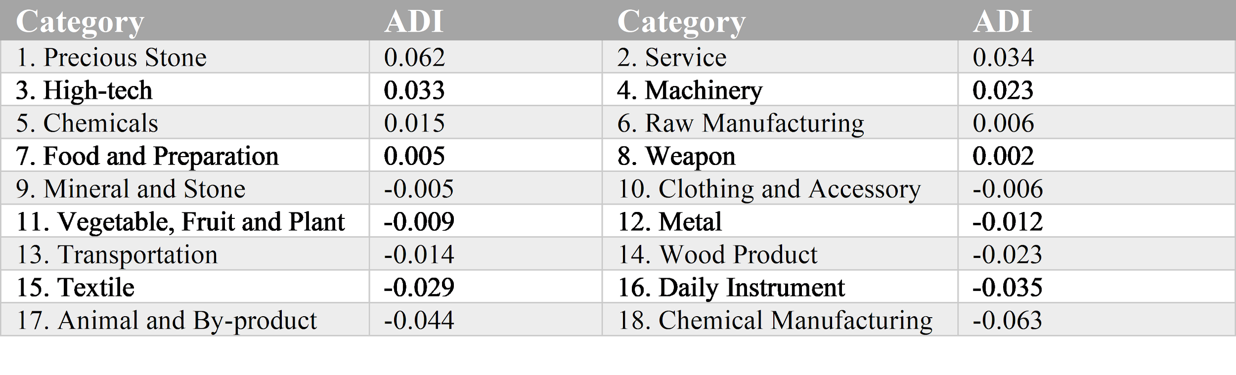
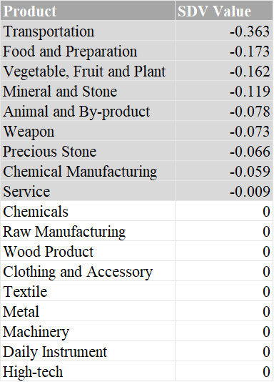
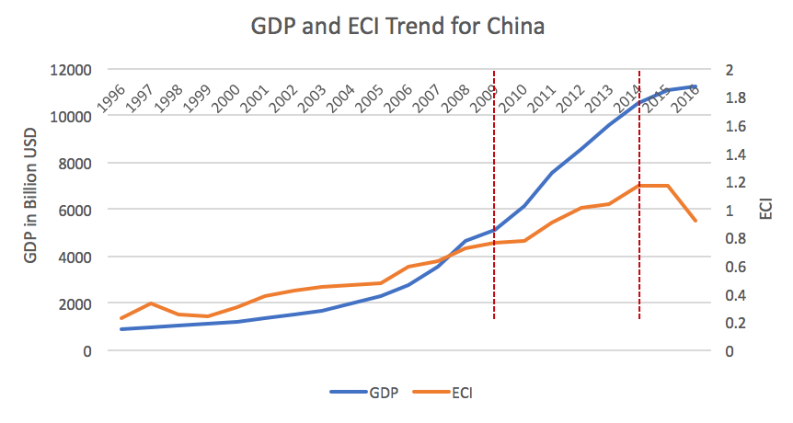
6.2 China
Table 1: Actual Development Index (ADI)
Table 2: Suggested Development Vector (SDV)

Slide 39
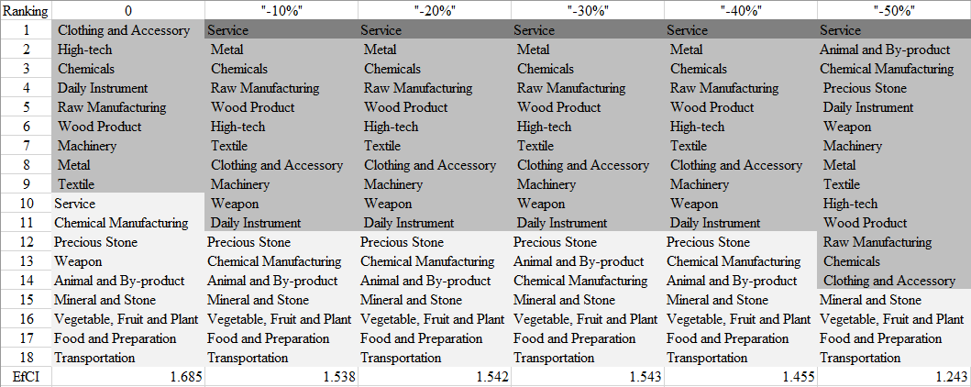
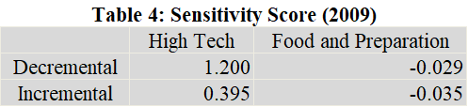
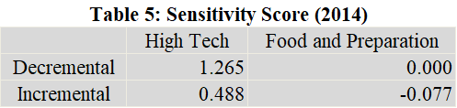
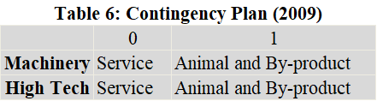
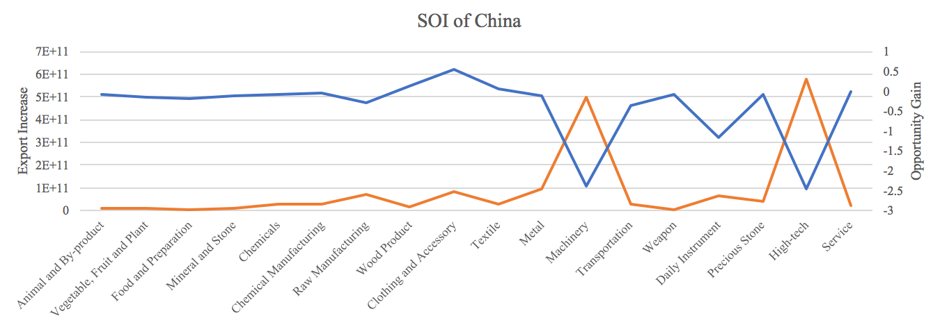
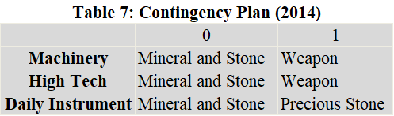
6.2 China
Table 3: High-tech Sensitivity Plan Table (2014)
SOI=82.8%

Slide 40
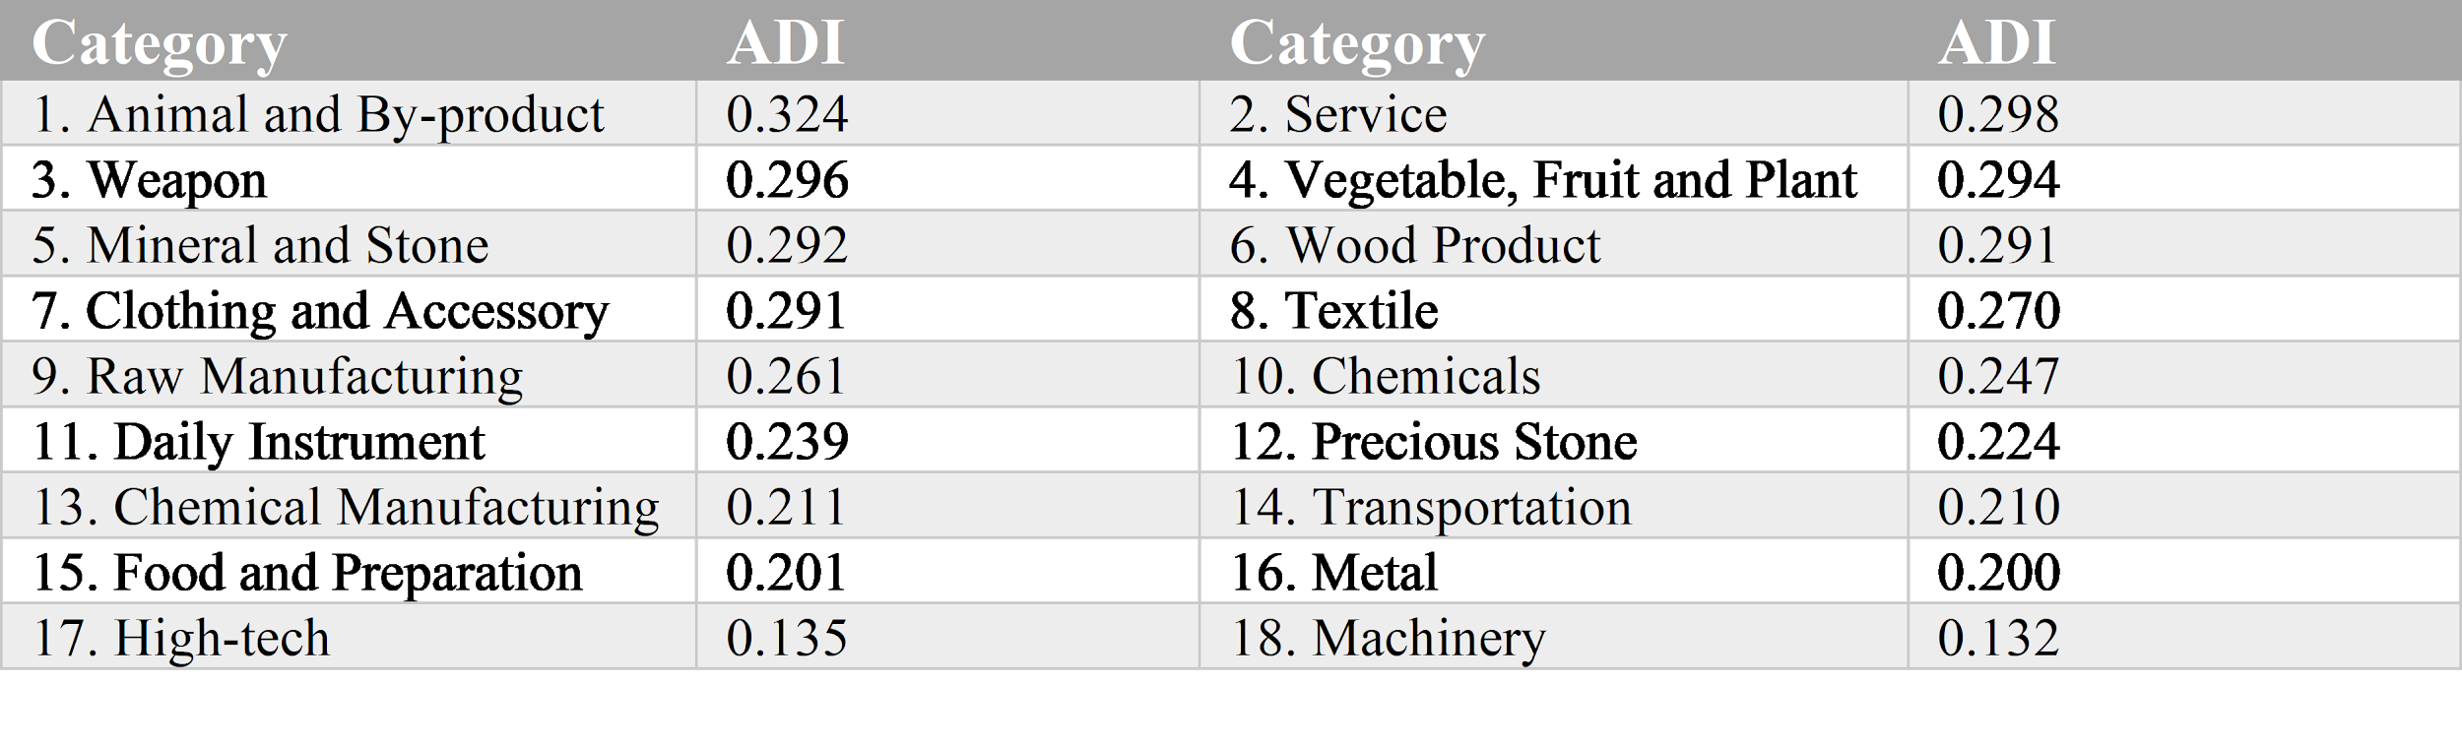
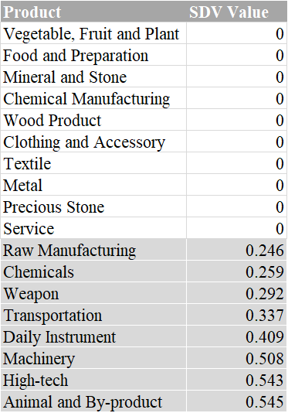
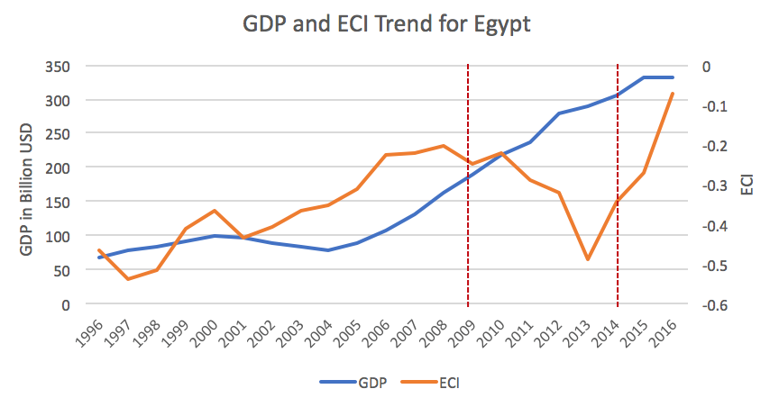
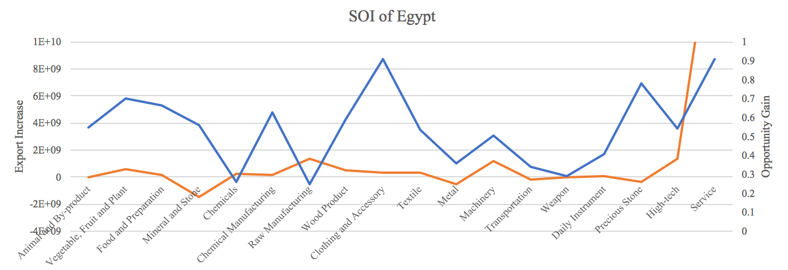
6.3 Egypt
Table 1: Actual Development Index (ADI)
Table 2: Suggested Development Vector (SDV)
SOI=19.2%

Slide 41
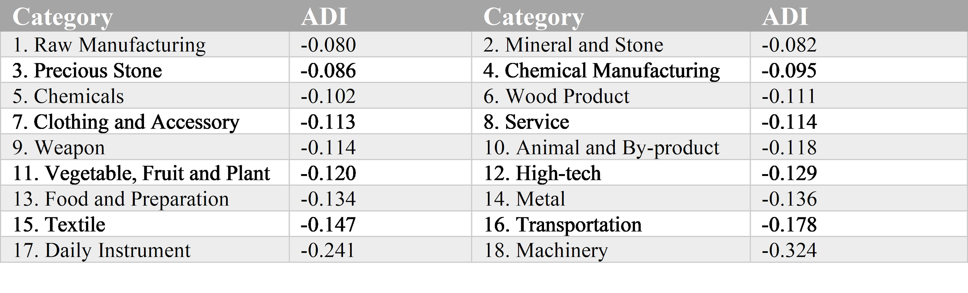
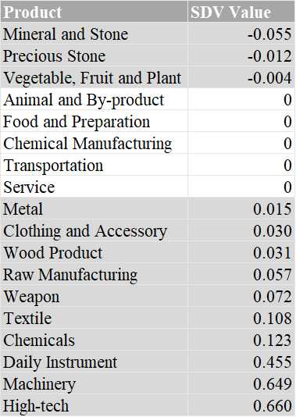
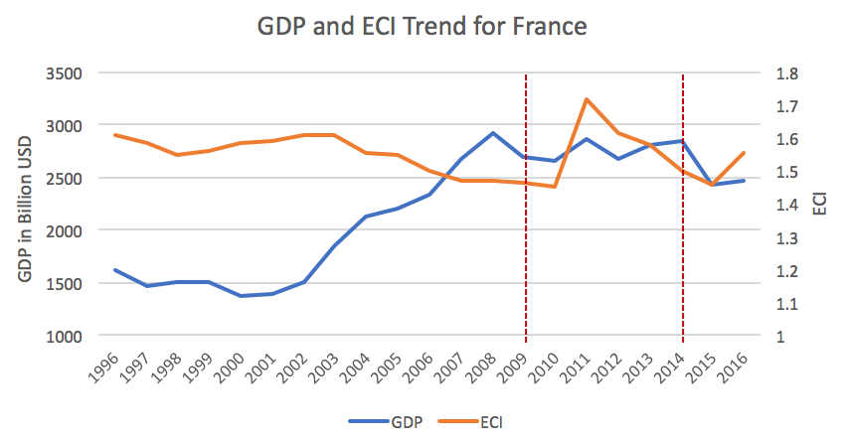
6.4 France
Table 1: Actual Development Index (ADI)
Table 2: Suggested Development Vector (SDV)

Slide 42
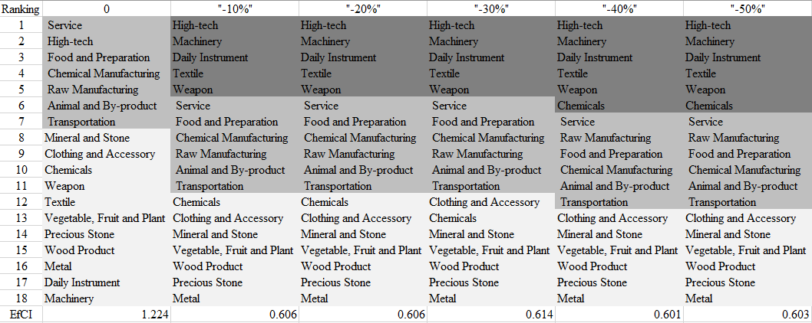
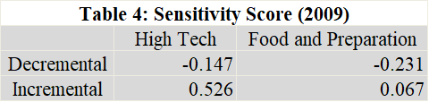
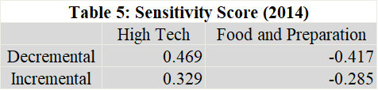
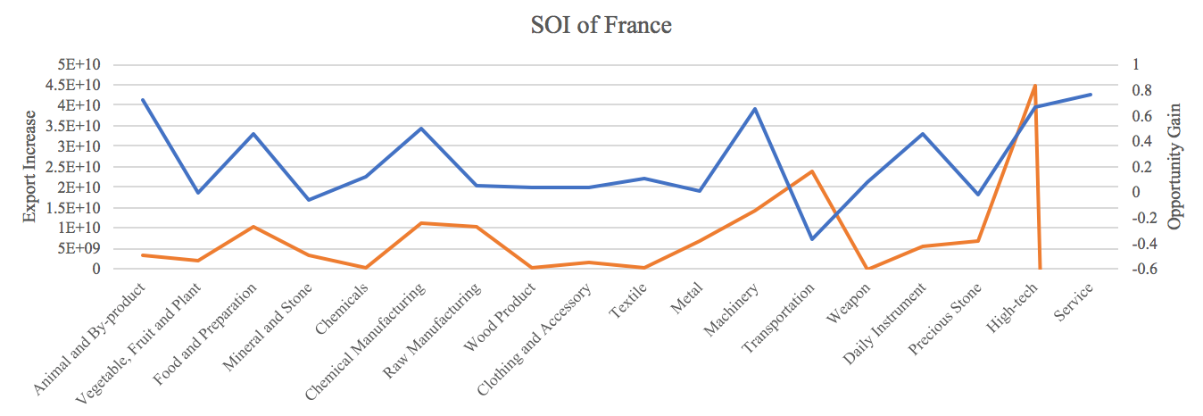
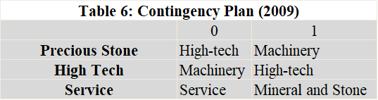
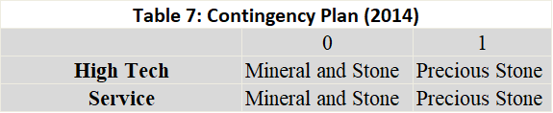
6.4 France
Table 3: High-tech Sensitivity Plan Table (2014)
SOI=14.2%

Slide 43
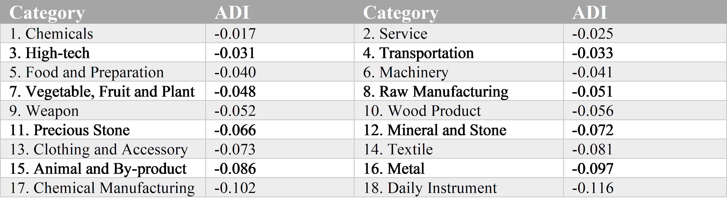
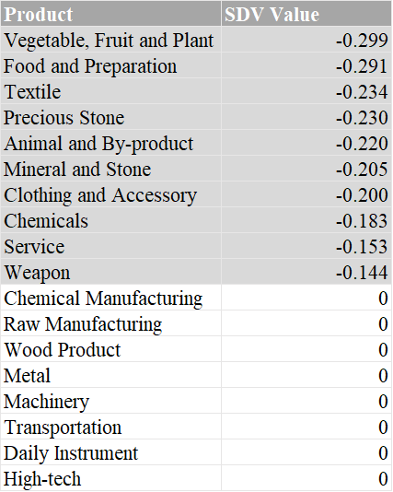
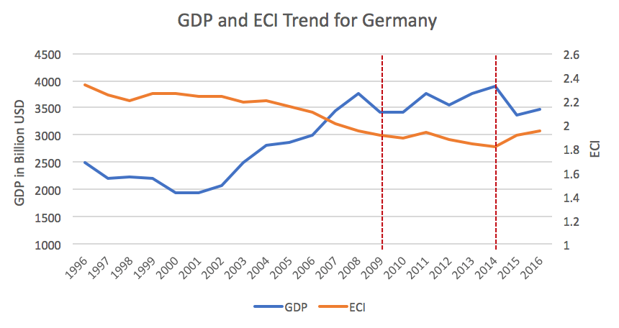
6.5 Germany
Table 1: Actual Development Index (ADI)
Table 2: Suggested Development Vector (SDV)

Slide 44
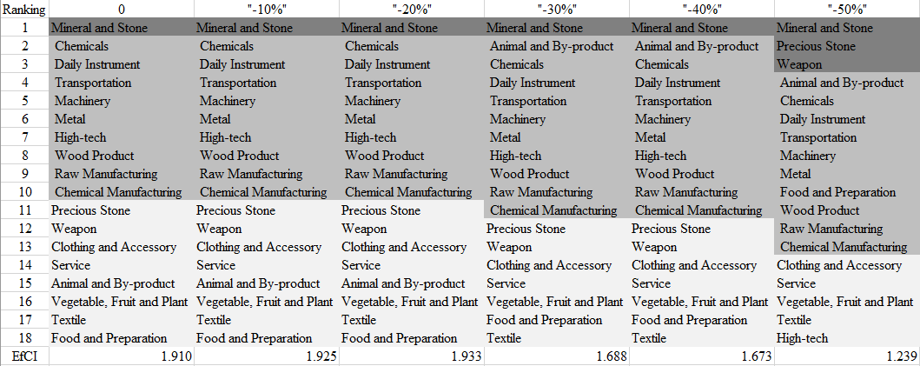
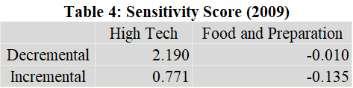
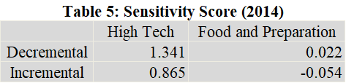
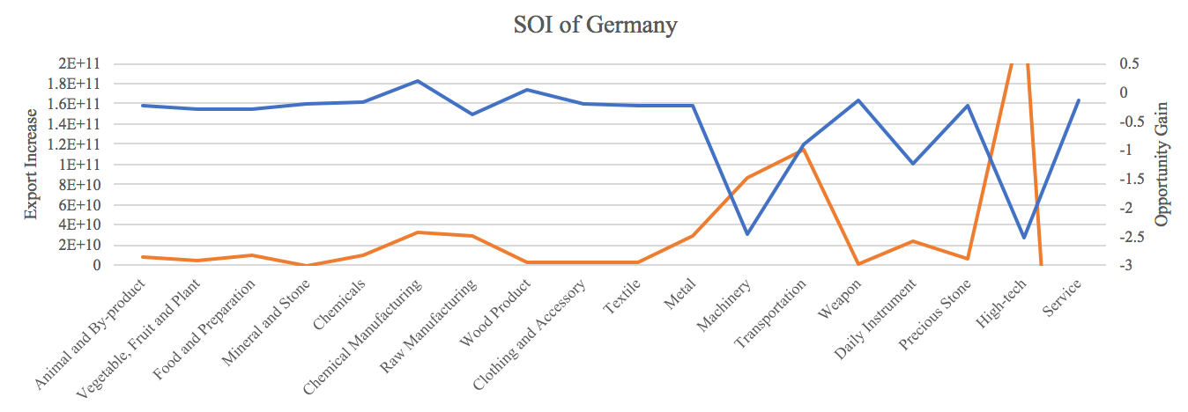


6.5 Germany
Table 3: High-tech Sensitivity Plan Table (2014)
SOI=19.4%

Slide 45



6.6 Japan
Table 1: Actual Development Index (ADI)
Table 2: Suggested Development Vector (SDV)

Slide 46




6.6 Japan
Table 3: High-tech Sensitivity Plan Table (2014)
SOI=58.3%

Slide 47



6.7 Malaysia
Table 1: Actual Development Index (ADI)
Table 2: Suggested Development Vector (SDV)

Slide 48





6.7 Malaysia
Table 3: High-tech Sensitivity Plan Table (2014)
SOI=10.2%

Slide 49



6.8 Mexico
Table 1: Actual Development Index (ADI)
Table 2: Suggested Development Vector (SDV)

Slide 50






6.8 Mexico
Table 3: High-tech Sensitivity Plan Table (2014)
SOI=68.3%

Slide 51




6.9 Morocco
Table 1: Actual Development Index (ADI)
Table 2: Suggested Development Vector (SDV)
SOI=29.7%

Slide 52




6.10 South Africa
Table 1: Actual Development Index (ADI)
Table 2: Suggested Development Vector (SDV)
SOI=1.3%

Slide 53



6.11 South Korea
Table 1: Actual Development Index (ADI)
Table 2: Suggested Development Vector (SDV)

Slide 54




6.11 South Korea
Table 3: High-tech Sensitivity Plan Table (2014)
SOI=48.3%

Slide 55




6.12 Spain
Table 1: Actual Development Index (ADI)
Table 2: Suggested Development Vector (SDV)
SOI=14.3%

Slide 56




6.13 Turkey
Table 1: Actual Development Index (ADI)
Table 2: Suggested Development Vector (SDV)
SOI=13.8%

Slide 57




6.14 United Arab Emirates
Table 1: Actual Development Index (ADI)
Table 2: Suggested Development Vector (SDV)
SOI=1.0%

Slide 58



6.15 USA
Table 1: Actual Development Index (ADI)
Table 2: Suggested Development Vector (SDV)

Slide 59






6.15 USA
Table 3: High-tech Sensitivity Plan Table (2014)
SOI=28.7%

Slide 60
7. Reference
Hausmann, R., Hidalgo, C., Bustos, S., Coscia, M., Chung, S., Jimenez, J., Simoes, A. and Yıldırım, M. (2007). The Atlas of Economic Complexity. [online] Atlas.cid.harvard.edu. Available at: http://atlas.cid.harvard.edu/.
Balassa, B., “The Purchasing Power Parity Doctrine - A Reapprais- al,” Journal of Political Economy 72, 584-596 (1964).
Feenstra, R.; Lipsey, R.; Deng, H.; Ma, A. & Mo, H. “World Trade Flows: 1962-2000” NBER working paper 11040. National Bureau of Economic Research, Cambridge MA (2005).
United Nations Commodity Trade Statistics Database (http://comtrade.un.org/db/), accessed in August 2011.
The World Economic Forum, “The global competitiveness re- port,” (various years).
Barro, R. & Lee, J-W. “A New Data Set of Educational Attainment in the World, 1950-2010,” NBER Working Paper No. 1590 (2010).
Kaufmann, D. & Kraay, A. “Governance Indicators: Where Are We, Where Should We Be Going?” Policy Research Working Paper 4370. Washington, DC: World Bank (2008).
Hanushek, E.A. & Woessmann, L. “The Role of Cognitive Skills in Economic Development,” Journal of Economic Literature 46(3), 607- 668 (2008).

